Slide 1
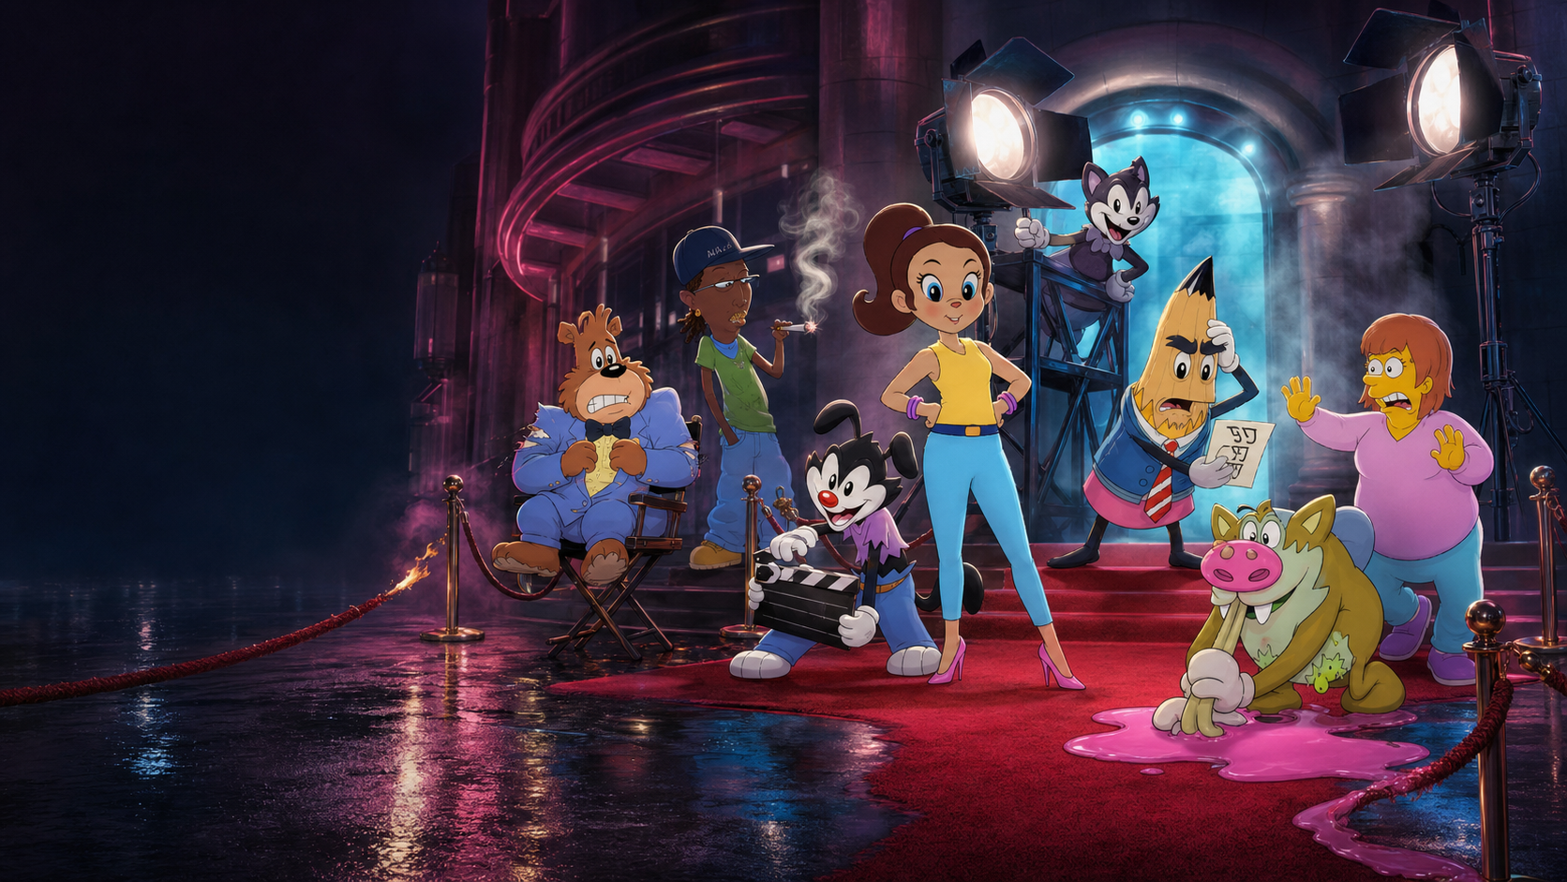


TAKE ONE-ISH
DAN GALEA PRESENTS
Eight unknowns.
One live show.
Absolutely no adult supervision.
ADULT ANIMATED
ENSEMBLE COMEDY
Notes:
[Sources]
- User-provided official Show Toons logo, character reference sheet and drawings; ensemble cover artwork generated with OpenAI image generation
- Show Toons project PDF, creator credit and premise — https://drive.google.com/file/d/1CuQpEfUvek612uspxidTdbziS_Aqx2CQ/view

Slide 2
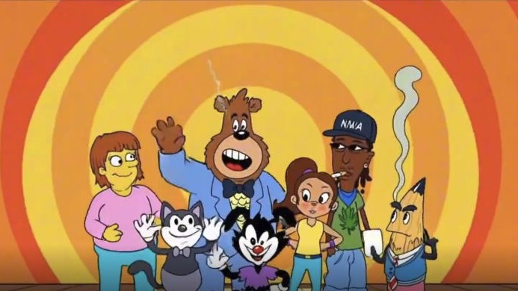
CUE PANIC
ONE STAGE.
EVERY TOON’S
BIGGEST BREAK.
A career-making live show. A backstage disaster waiting to happen.
WATCH THE TRAILER →
CLICK TO OPEN
THE HOOK
02
Notes:
[Sources]
- Show Toons trailer, ensemble stage still at approximately 40 seconds — https://drive.google.com/file/d/1mhmvxmGackzKDAmY85VN49PYr1h6wG6P/view
- Trailer link — https://drive.google.com/file/d/1mhmvxmGackzKDAmY85VN49PYr1h6wG6P/view

Slide 3
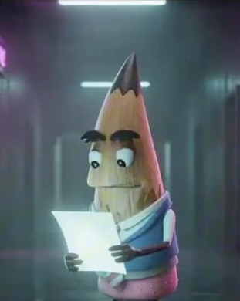
TOTALLY NORMAL
SATURDAY NIGHT LIGHTS.
WEEKDAY DISASTERS.
KEWL: The Night Time Special Show is the most prestigious stage in Toon City—the place unknown cartoons go to become stars.
Think SATURDAY NIGHT LIVE meets THE LARRY SANDERS SHOW: live sketches, celebrity hosts and musical performances—plus the rivalries, secrets and fallout the audience never sees.
SERIES PROMISE
03
Notes:
[Sources]
- Show Toons project PDF, synopsis and format comparison — https://drive.google.com/file/d/1CuQpEfUvek612uspxidTdbziS_Aqx2CQ/view
- Show Toons trailer, Peter Pencilman backstage still at approximately 20 seconds — https://drive.google.com/file/d/1mhmvxmGackzKDAmY85VN49PYr1h6wG6P/view

Slide 4
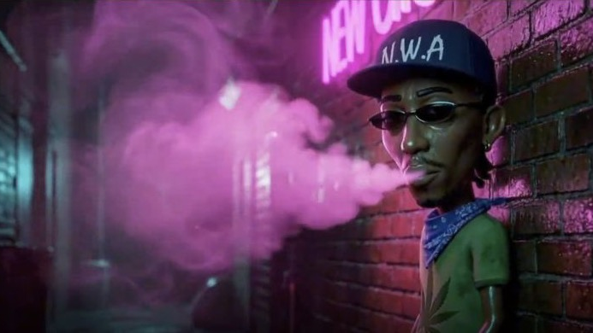
TOON CITY RUNS ON
EGO, DESPERATION
AND ONE SHOT
AT PRIME TIME.
CITY OF DREAMS*
THE STAGE
THE BACKLOT
AFTER HOURS
The dream every toon recognizes.
Where ambition becomes material.
Where consequences start moving.
THE WORLD
04
Notes:
[Sources]
- Show Toons project PDF, Toon City and Afterlife Studios setting — https://drive.google.com/file/d/1CuQpEfUvek612uspxidTdbziS_Aqx2CQ/view
- Show Toons trailer, Toon City still at approximately 30 seconds — https://drive.google.com/file/d/1mhmvxmGackzKDAmY85VN49PYr1h6wG6P/view

Slide 5
EVERY EPISODE ENDS IN DAMAGE CONTROL.
A repeatable comic engine with consequences that carry forward.
01
02
03
THE SHOW
THE PRESSURE
THE FALLOUT
Guest host. Musical act. Sketches. A live deadline.
Network notes. Rivalries. Secrets. A cast barely holding.
Backstage choices bleed into the performance—and the season.
The format resets the stage every week. The characters never reset.
CLEAN IT. RESET IT.
EPISODE ENGINE
05
Notes:
[Sources]
- Show Toons project PDF, synopsis: live show, hosts, musical performances, sketches and backstage through-lines — https://drive.google.com/file/d/1CuQpEfUvek612uspxidTdbziS_Aqx2CQ/view

Slide 6
A CAST
NOBODY ELSE
WANTED.
EXACTLY
THE POINT.
Eight misfits. One turnaround season.
Pencilman’s reputation on the line.
THEY ARE THE FORMAT.
THE ENSEMBLE
06
Notes:
[Sources]
- Show Toons project PDF, ensemble premise — https://drive.google.com/file/d/1CuQpEfUvek612uspxidTdbziS_Aqx2CQ/view
- Show Toons trailer, ensemble Toon City still at approximately 80 seconds — https://drive.google.com/file/d/1mhmvxmGackzKDAmY85VN49PYr1h6wG6P/view

Slide 7
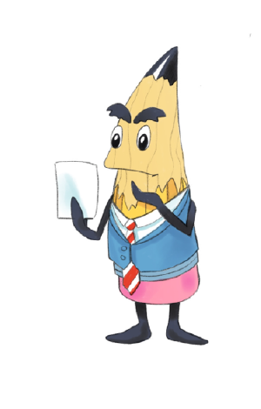
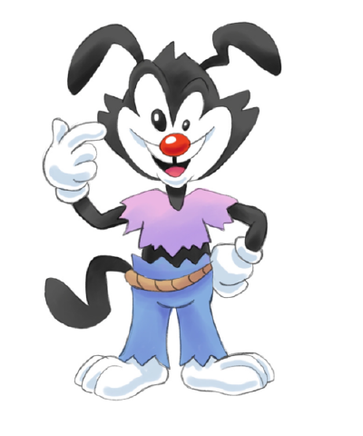
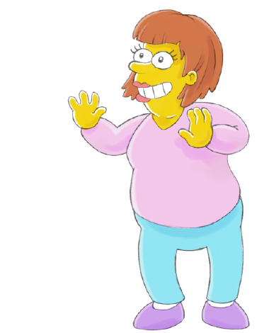
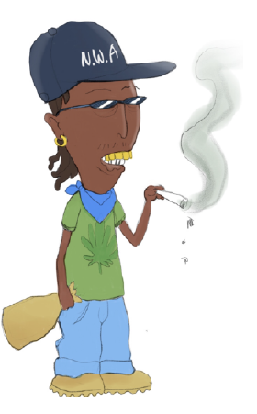
THE BET: PENCILMAN’S FIRST FOUR WILD CARDS.
PETER PENCILMAN
JACKO
WANDA
BURN
THE LEGEND
THE SECRET WEAPON
THE VETERAN
THE SLEEPER
Exacting. Emotionless. Betting KEWL on misfits.
Hyper. Unfiltered. Usually the wrong idea.
Five years in. Not surrendering her turf.
Rough exterior. Serious talent. Good heart.
CHARACTER BIBLE
07
Notes:
[Sources]
- Show Toons project PDF, original character art and character bible — https://drive.google.com/file/d/1CuQpEfUvek612uspxidTdbziS_Aqx2CQ/view

Slide 8
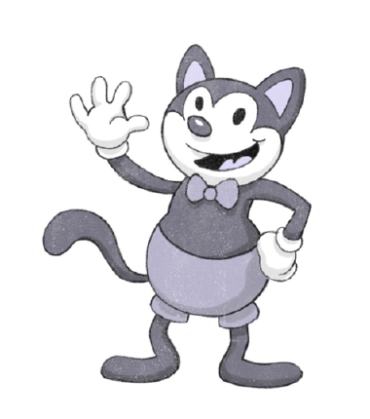
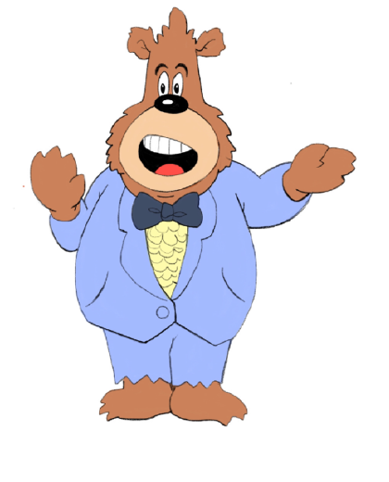

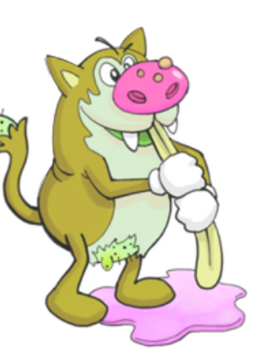
FOUR MORE WAYS TO GO OFF SCRIPT.
CALVIN KITTEN
BONGO THE BEAR
DONNA
CRUNCHY
THE ORIGINAL
THE NETWORK
THE STAR
THE WILDCARD
Old-school charm. KEWL’s first-cast ghost.
Network power. Classic gags. Catastrophic notes.
Born promoter. Confidence with a blast radius.
Gross-out instinct. Mood swings. Pencilman sees genius.
CHARACTER BIBLE
08
Notes:
[Sources]
- Show Toons project PDF, original character art and character bible — https://drive.google.com/file/d/1CuQpEfUvek612uspxidTdbziS_Aqx2CQ/view

Slide 9
THE OPENING RUN TURNS STRANGERS INTO A SHOW.
Six episodes move from risky auditions to a haunted opening night.
01
THE ODD-ITIONS
04
FINDING JACKO
Pencilman bets his reputation on diamonds in the rough.
The cast’s first team test is more elaborate than it looks.
02
THE CHOSEN ONES
05
WRITERS AND WRONGERS
The celebration begins—and careers are already in danger.
Personal chaos becomes material in the writers’ room.
03
TOON IN NEXT TIME
06
THE SPOOK-TACULAR FIRST EPISODE
A hungover exit from home leaves one toon missing.
Opening night turns haunted, dangerous and live.
OPENING NIGHT-ISH
SEASON RUNWAY
09
Notes:
[Sources]
- Show Toons project PDF, episode guide for episodes 1–6 — https://drive.google.com/file/d/1CuQpEfUvek612uspxidTdbziS_Aqx2CQ/view

Slide 10
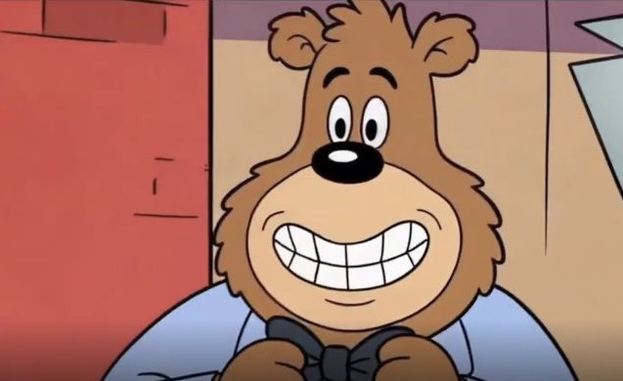
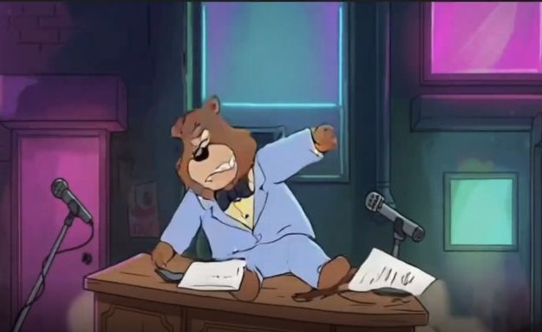
CLASSIC
CARTOON
PHYSICS.
BONK, BUT PRESTIGE
MODERN
ADULT
STAKES.
Backstage satire, slapstick, serialized relationships and heightened set pieces—all driven by characters who need this break more than they can admit.
TONE & RANGE
10
Notes:
[Sources]
- Show Toons project PDF, synopsis and character-based comedy — https://drive.google.com/file/d/1CuQpEfUvek612uspxidTdbziS_Aqx2CQ/view
- Show Toons trailer, Bongo stills at approximately 50 and 60 seconds — https://drive.google.com/file/d/1mhmvxmGackzKDAmY85VN49PYr1h6wG6P/view

Slide 11
THE WORLD IS ALREADY BUILT.
The current package gives buyers a clear premise, a recognizable ensemble and an opening-season runway.
CREATED BY
DAN
GALEA
01
FINISHED TRAILER
02
SERIES PREMISE + FORMAT
03
EIGHT-CHARACTER BIBLE
ORIGINAL CHARACTER DRAWINGS
04
SIX-EPISODE OPENING RUN
BRANDON
KOEPKE
05
THEME-SONG CONCEPT
CONTENTS: EXPLOSIVE
CREATIVE PACKAGE
11
Notes:
[Sources]
- Show Toons project PDF, package contents, creator credit and original character-drawing credit — https://drive.google.com/file/d/1CuQpEfUvek612uspxidTdbziS_Aqx2CQ/view
- Show Toons trailer file — https://drive.google.com/file/d/1mhmvxmGackzKDAmY85VN49PYr1h6wG6P/view

Slide 12
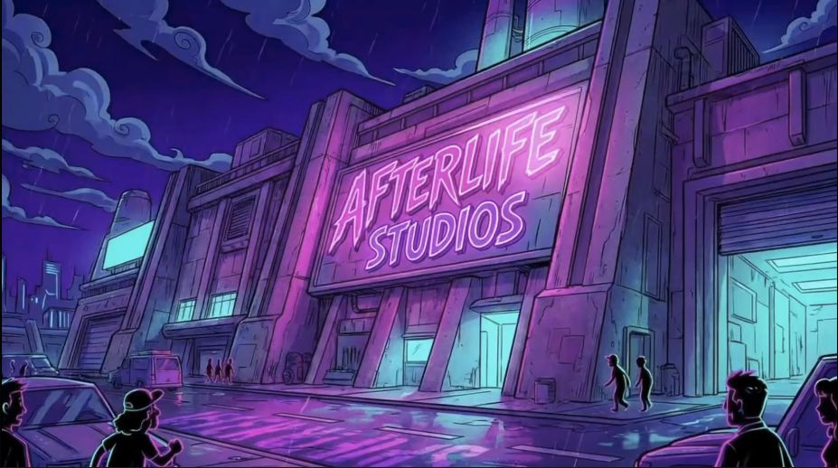
ROLL CREDITS?
THE NEXT GREAT TOON
ISN’T FAMOUS YET.
Show Toons is the story of the season that finally gives them the shot.
WATCH THE TRAILER →
OPEN SOURCE FOLDER →
THE INVITATION
12
Notes:
[Sources]
- User-provided official Show Toons logo
- Show Toons project PDF, series premise — https://drive.google.com/file/d/1CuQpEfUvek612uspxidTdbziS_Aqx2CQ/view
- Show Toons trailer, Afterlife Studios still and trailer link — https://drive.google.com/file/d/1mhmvxmGackzKDAmY85VN49PYr1h6wG6P/view
- User-provided project folder — https://drive.google.com/drive/folders/1jXbCZoAX1xyDiROf8NKFhhWx6Y_okoYU

